Slide 1
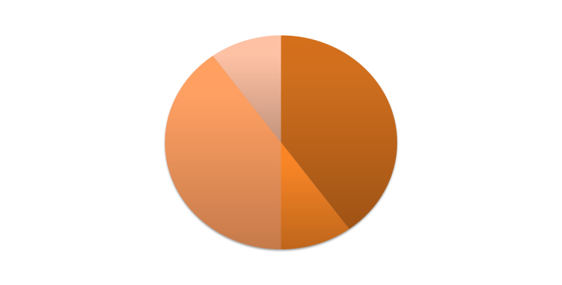
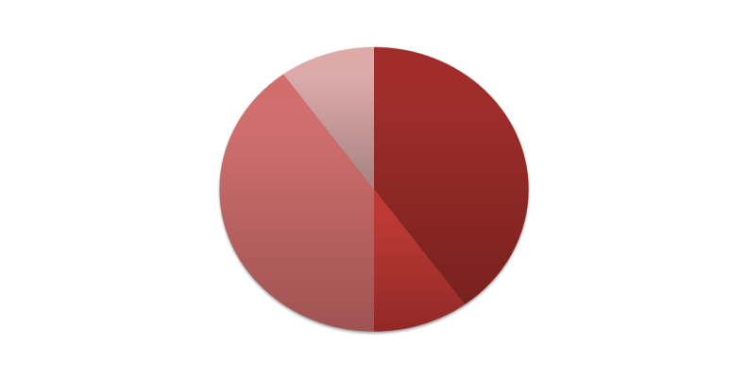
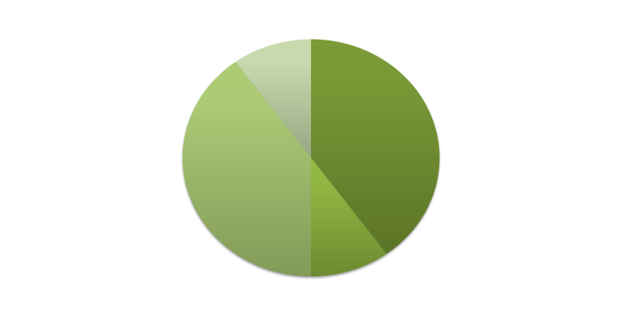
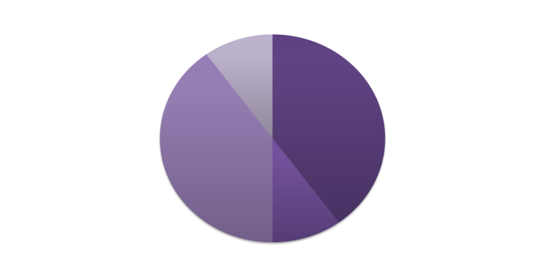
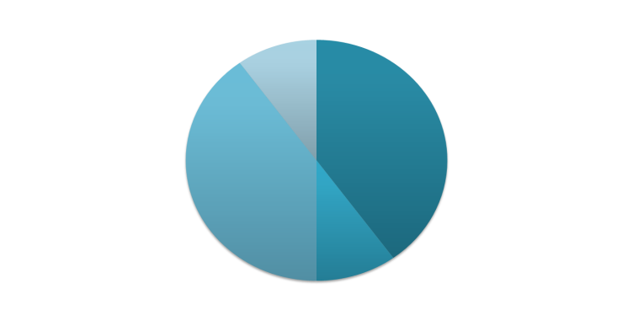
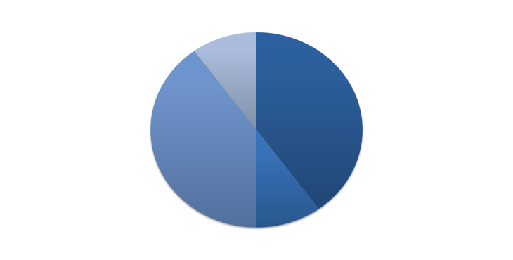

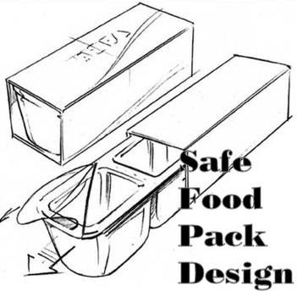

FMECAENGINE a seamless tool to chain migration simulations and perform related sensitivity analysis
Version 0.45
(Windows & Linux i386/x64)
olivier.vitrac@agroparistech.fr
August, 2011

Slide 2
LICENSE
FMECAengine is developed by Olivier Vitrac, PhD (Institut National de la Recherche Agronomique) and distributed under licence CeCILL-B (compatible GPL) as detailed below.
CeCILL-B FREE SOFTWARE LICENSE AGREEMENT
http://www.cecill.info/licences/Licence_CeCILL-B_V1-en.html
Notice
This Agreement is a Free Software license agreement that is the result of discussions between its authors in order to ensure compliance with the two main principles guiding its drafting:
firstly, compliance with the principles governing the distribution of Free Software: access to source code, broad rights granted to users,
secondly, the election of a governing law, French law, with which it is conformant, both as regards the law of torts and intellectual property law, and the protection that it offers to both authors and holders of the economic rights over software.

Slide 3
GOALS
FMECAengine implements FMECA concepts (http://en.wikipedia.org/wiki/FMECA) while being compatible with the underlying physics of mass transfer between food packaging and food.
a formalism as an expert system that enables the simulation of various migration scenarios and the coupling with heterogeneous databases, rulebases and knwoledge bases from industry, final users, research laboratory…
Possible scopes: identification of critical steps within a food packaging flow chart (setoff, hot filling, long term storage, household heating…); seeking critical migrants for various designs (e.g. from adhesives, inks); concurrent design of complex food packaging systems (multicomponents, multilayers).

Slide 4
VERSION HISTORY
Generating migration scenarios (version 0.1)
Simulating chained scenarios (version 0.2)
Sensitivity analysis (version 0.3)
Severity and criticality analysis (version 0.38)
Connecting with physico-chemical databases (version 0.41)
Multiple keys enabled in versions 0.43 and later

Slide 5
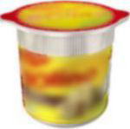
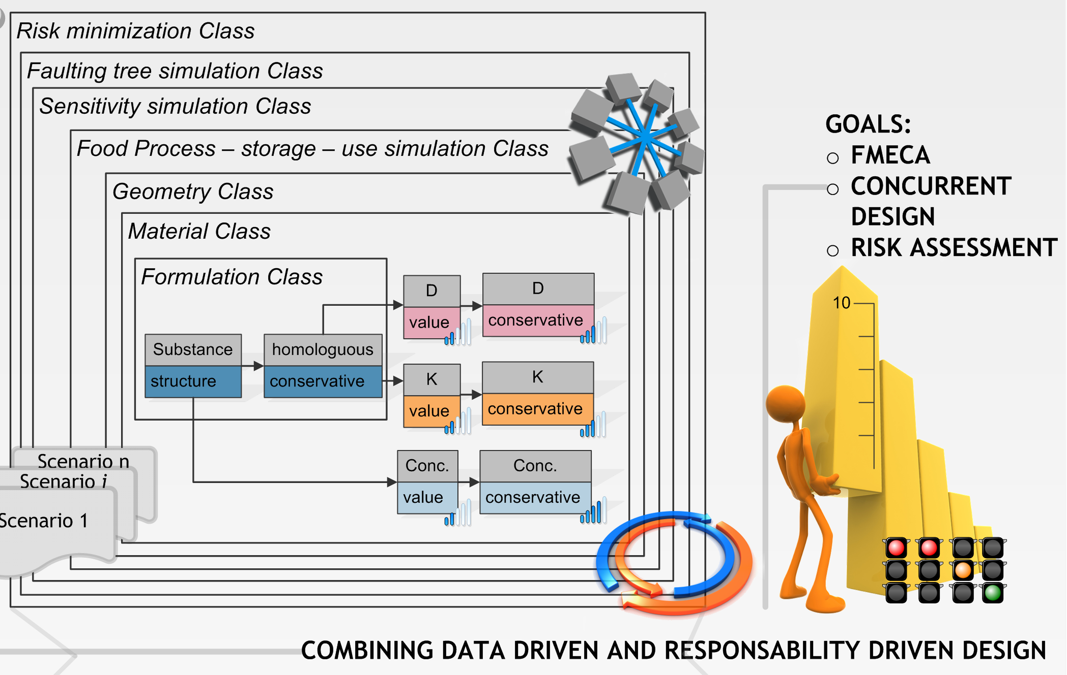
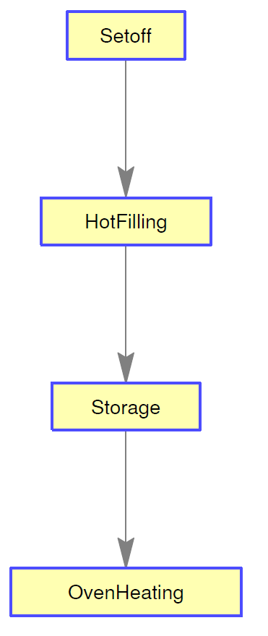
Which kind of problem can be solved ?

Slide 6

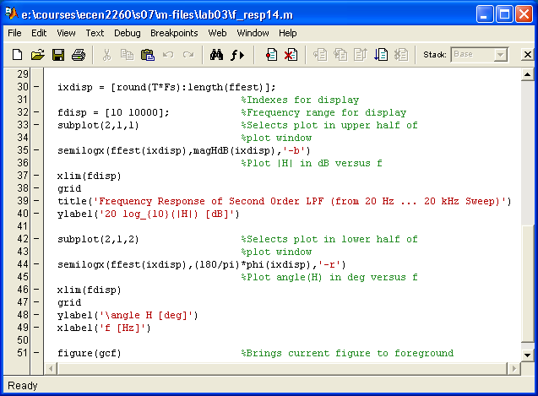


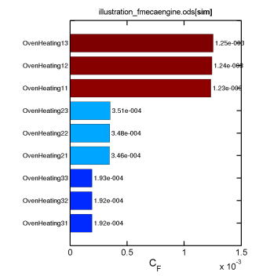
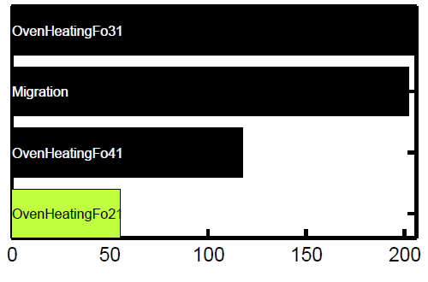
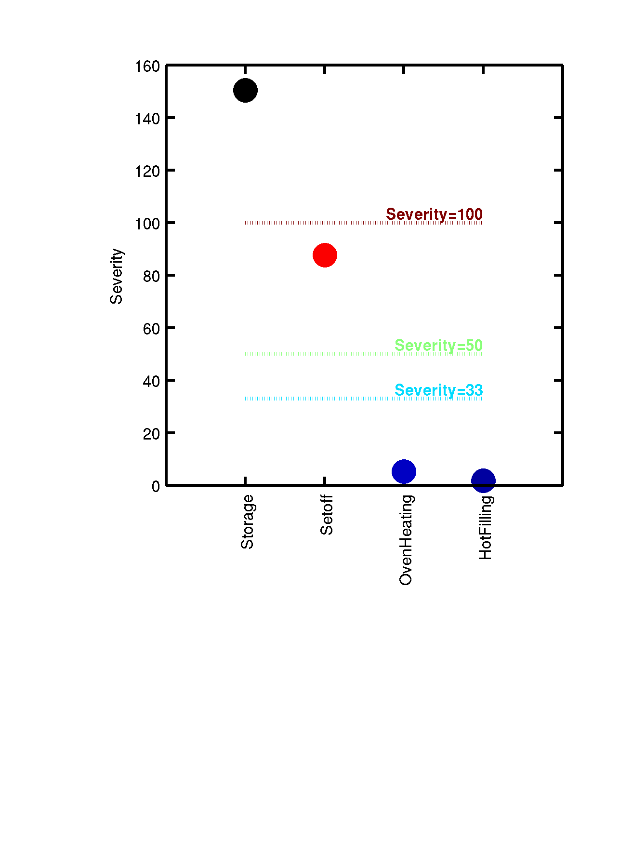
FMECAENGINE architecture
FMECADB
Polymer
Simulation 1
.
.
.
Simulation n
Name : PP
Composition : antioxidant
Additive
Scenarios
Name : BHT
PMREF : 46640
CAS : 128-37-0
M : 220
SML : 3
Class : antioxidant
Time
lF
li
SML
CP°i
Di
KFPi
FMECAENGINE
Sensitivity
Monomer
Name : propylene
PMREF : 23980
CAS : 115-07-1
M : 42
SML : 60
Class : propylene
Updated scenarios
Severity and criticality
On a signe computer or on a cluster of computer

Slide 7
What is chained simulation ?
Principles : inherited parameters, parental bond
Toy example
[P1]
[P2]
[P3]
[P4]
Step1
Step2
Step3
Step4

Slide 8
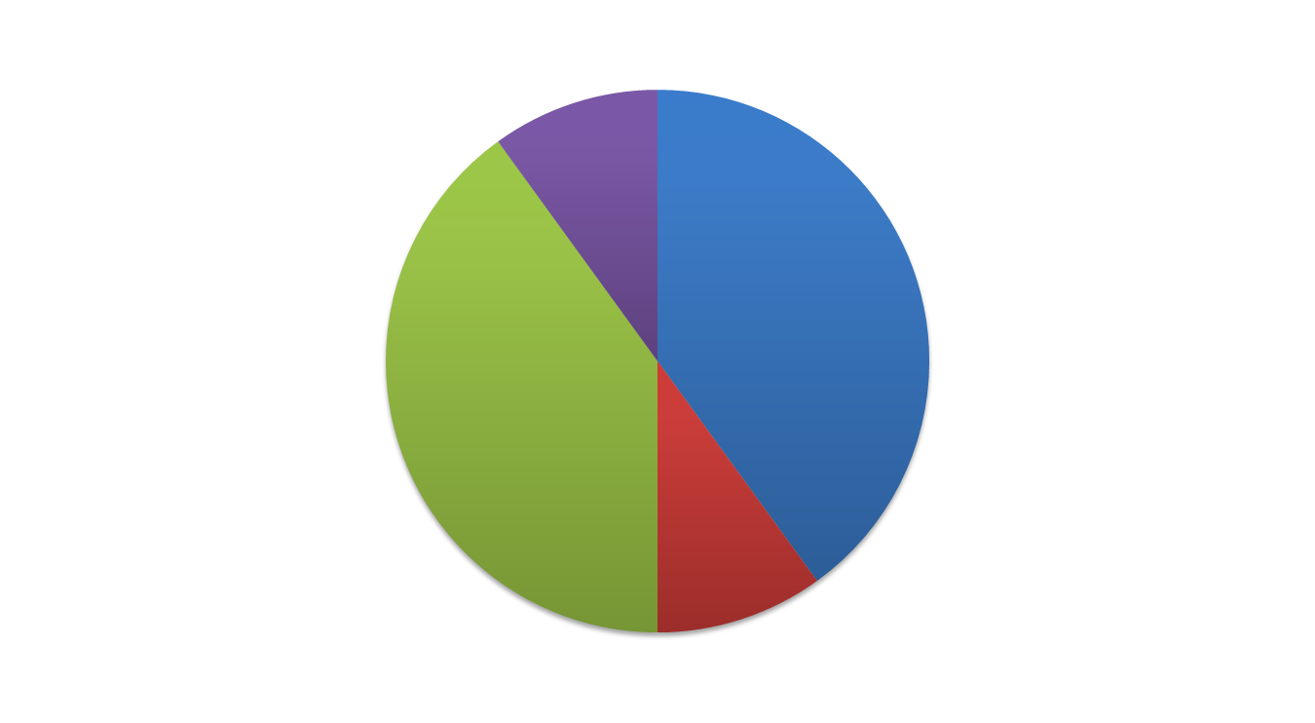
What is migration simulation?
Parameter vector inherited from step k [p]_{k} + sparse modification [δp]_{n}
Result from a
previous simulation
(e.g. time x space concentration field denoted [c]_{n-1})
input
output
Simulated result
(denoted [c]_{n})
[p]_{n}= [p]_{k} +[δp]_{n}
to propagate inheritance

Slide 9










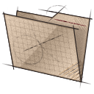


Object/parallel implementation
Programming within
a spreadsheet (ODS files preferred)
input/
output/
Onput folder including
Output files
Input folder(s)
Database(s) available
for future use

Slide 10
GOAL: solve complex simulation scenarios with simple inheritance operators and sparse parameters
[δp]_{C}
[p]_{A}
C inherits of parameters of A
C inherits of parameters of B
C reuses the output of B (B is the parent of C)
A
[p]_{B}
B
C
[c]_{C}=f_{C}([p]_{C})
[p]_{C}= [p]_{A} + [p]_{B} +[δp]_{C}
Bold=higher precedence

Slide 11
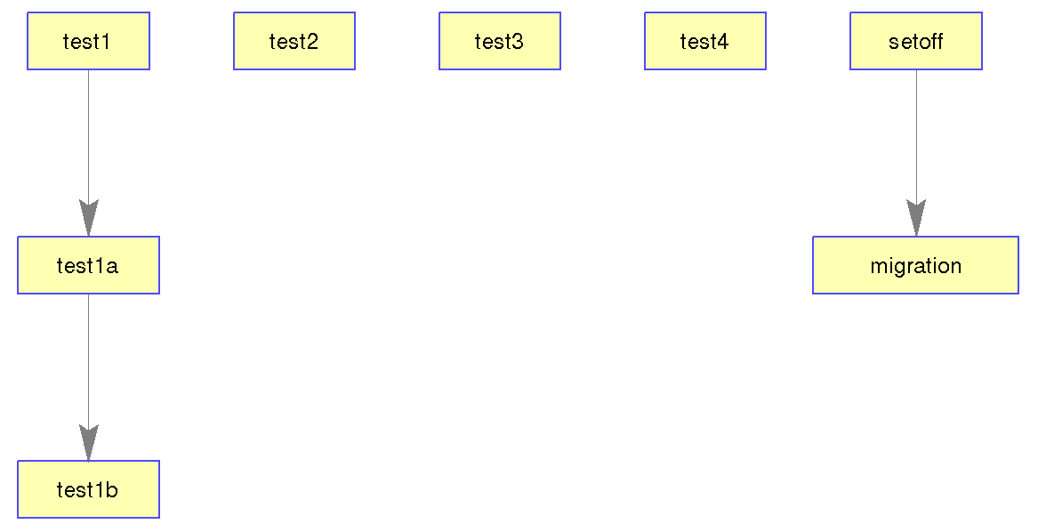
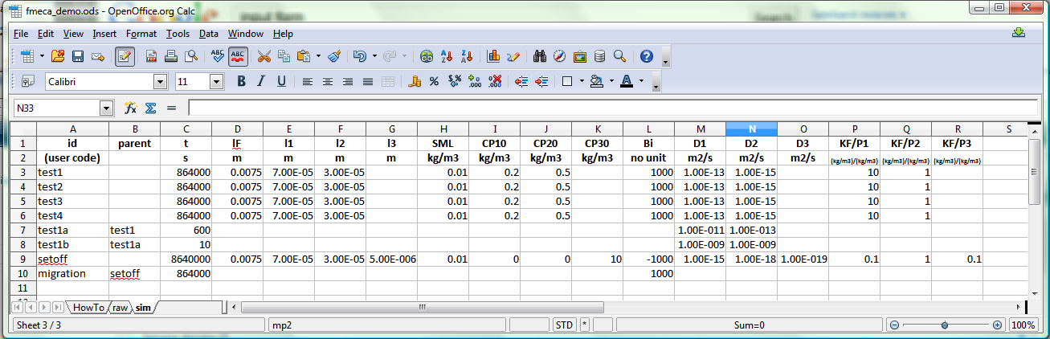
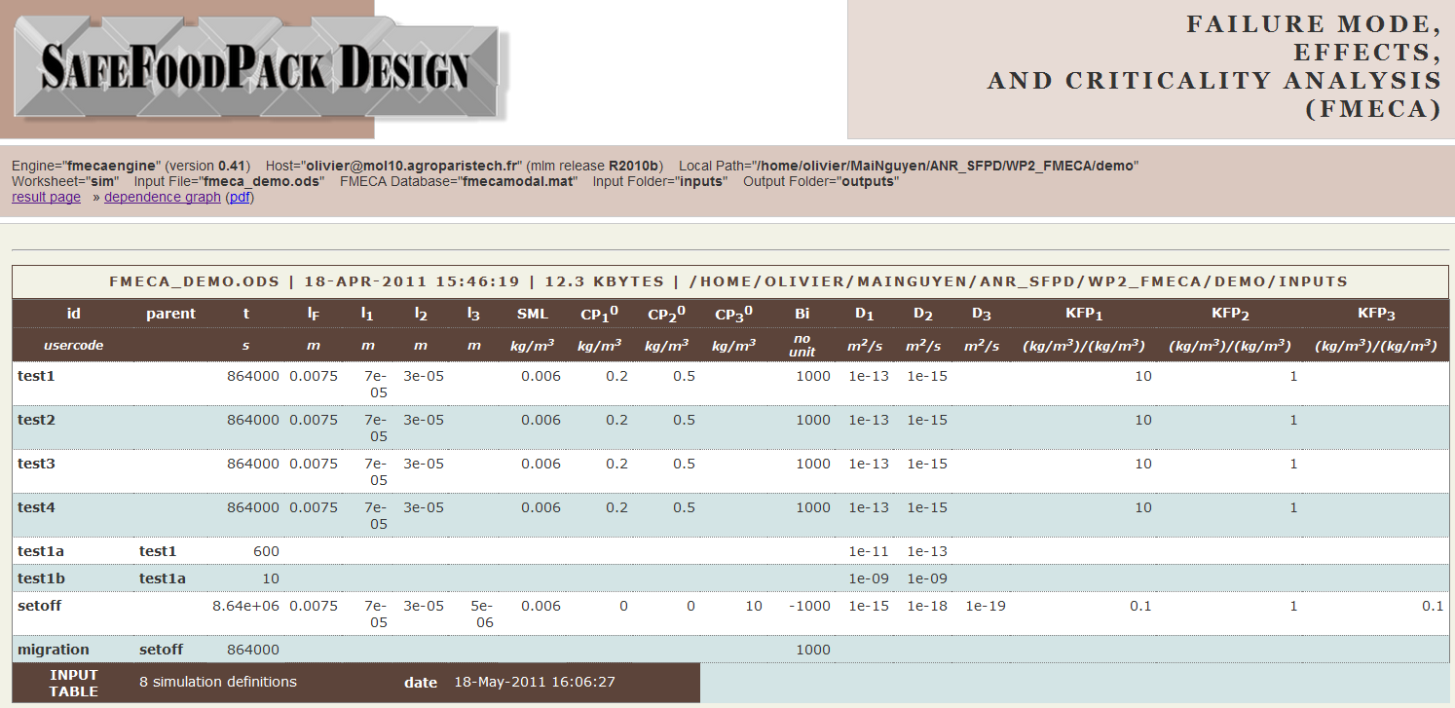
TOY EXAMPLE: input table
INPUT TABLE =OpenOffice worksheet (ODS v. 3)
dependence graph
plotted by FMECAENGINE
ORIGINAL TABLE repainted by FMECAENGINE

Slide 12
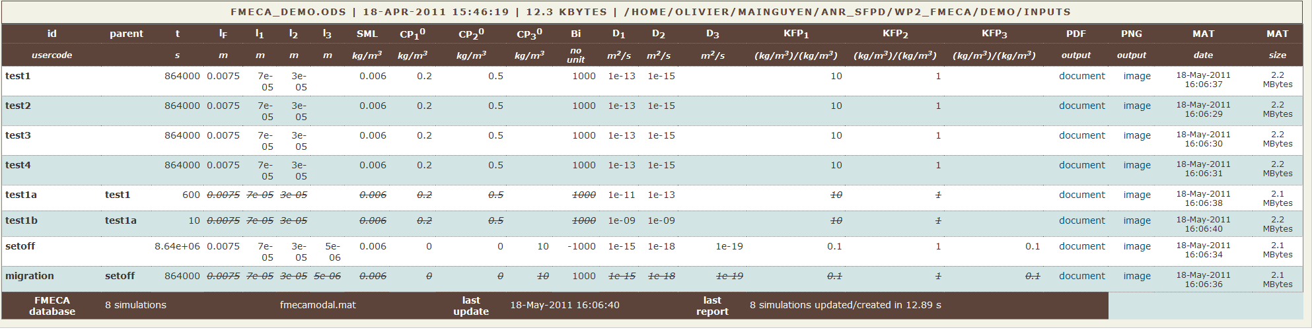
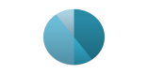
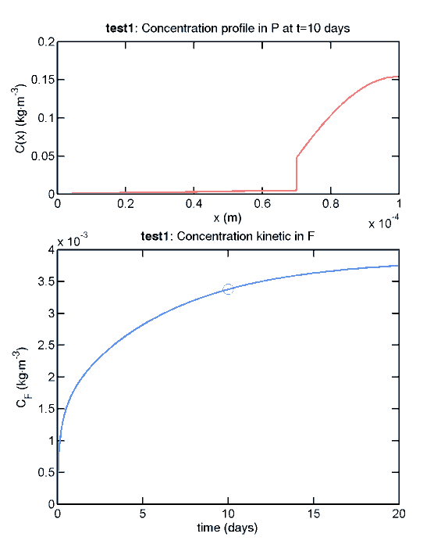
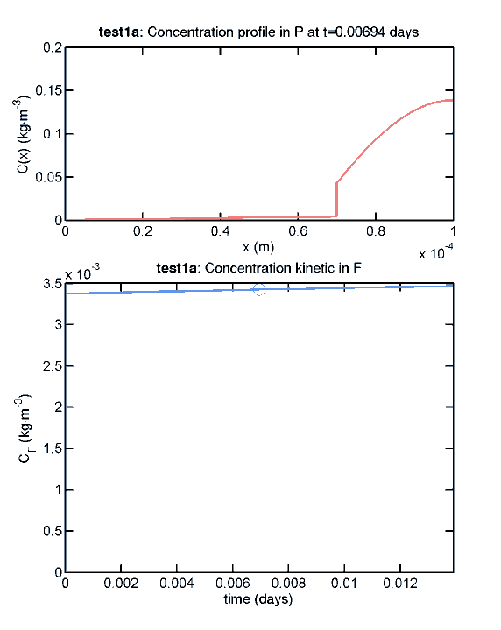
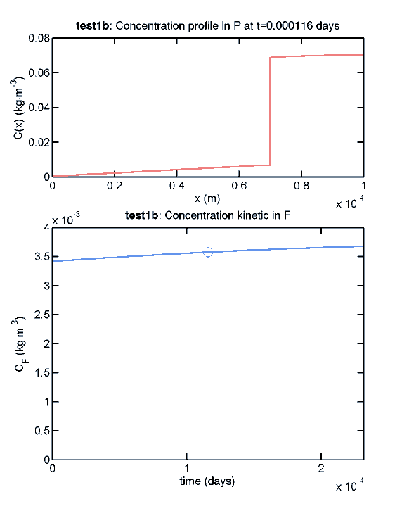
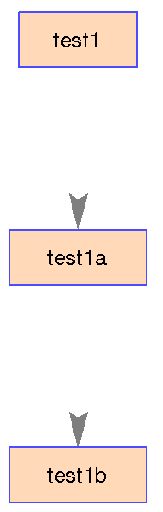
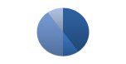

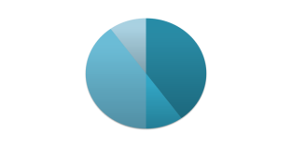
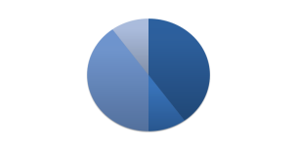
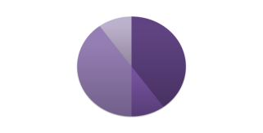
TOY EXAMPLE: output table
Chaining defined via ancestors
Results available as links
Simulations without parent are independent.
Line-through values are inherited from their parents.
Links give direct access to plots.

Slide 13
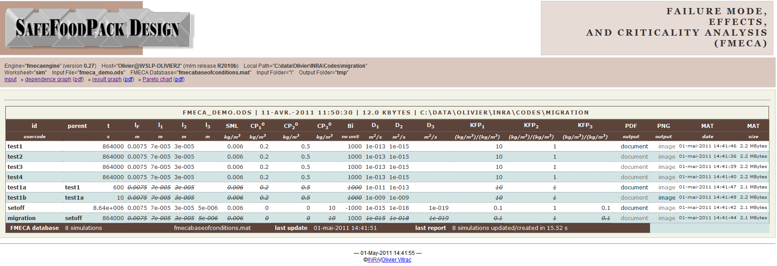
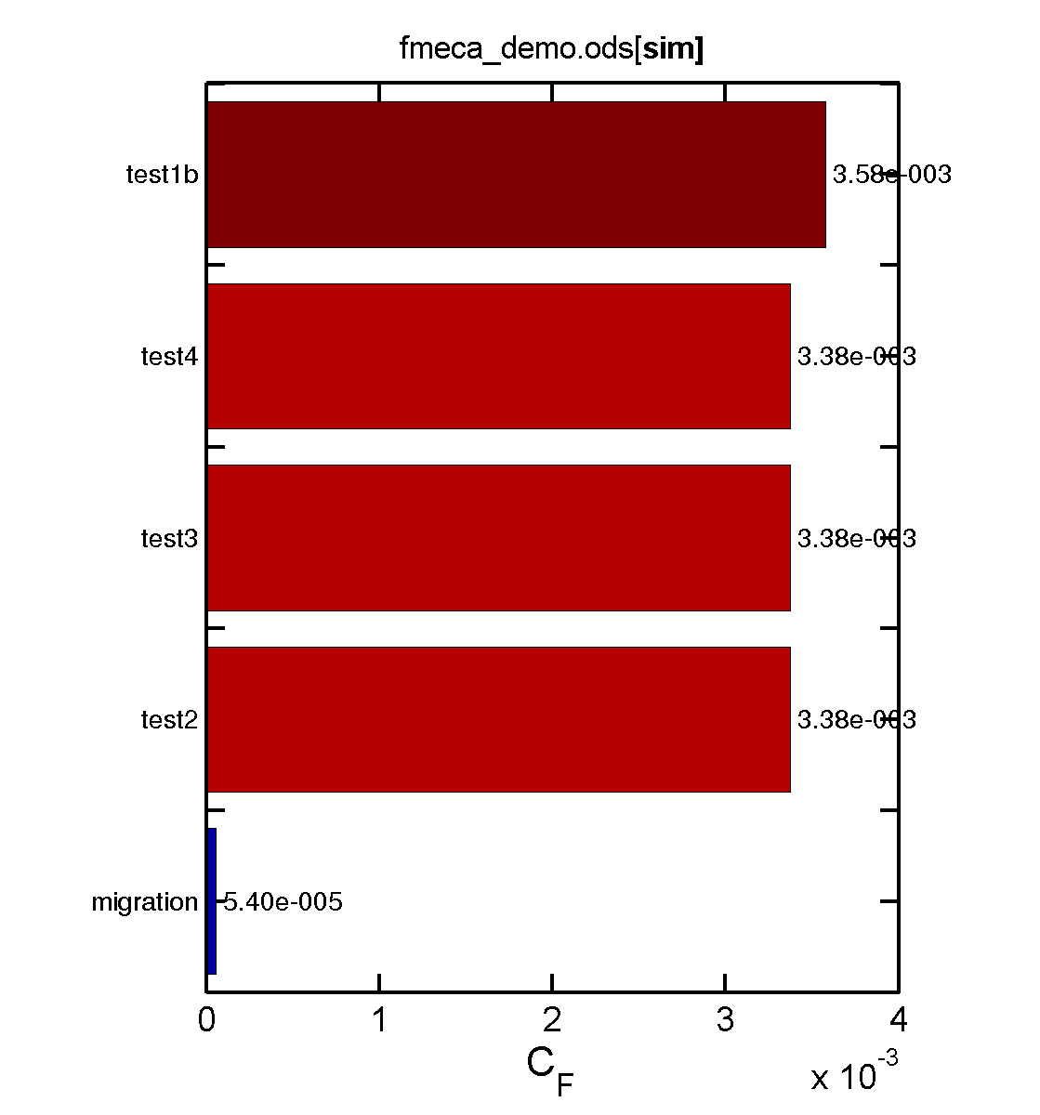
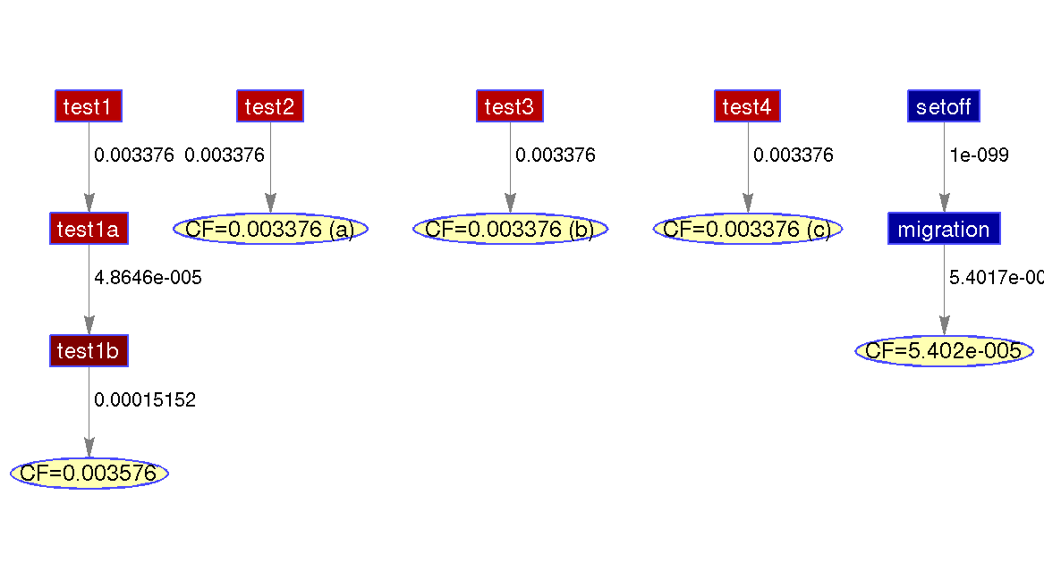
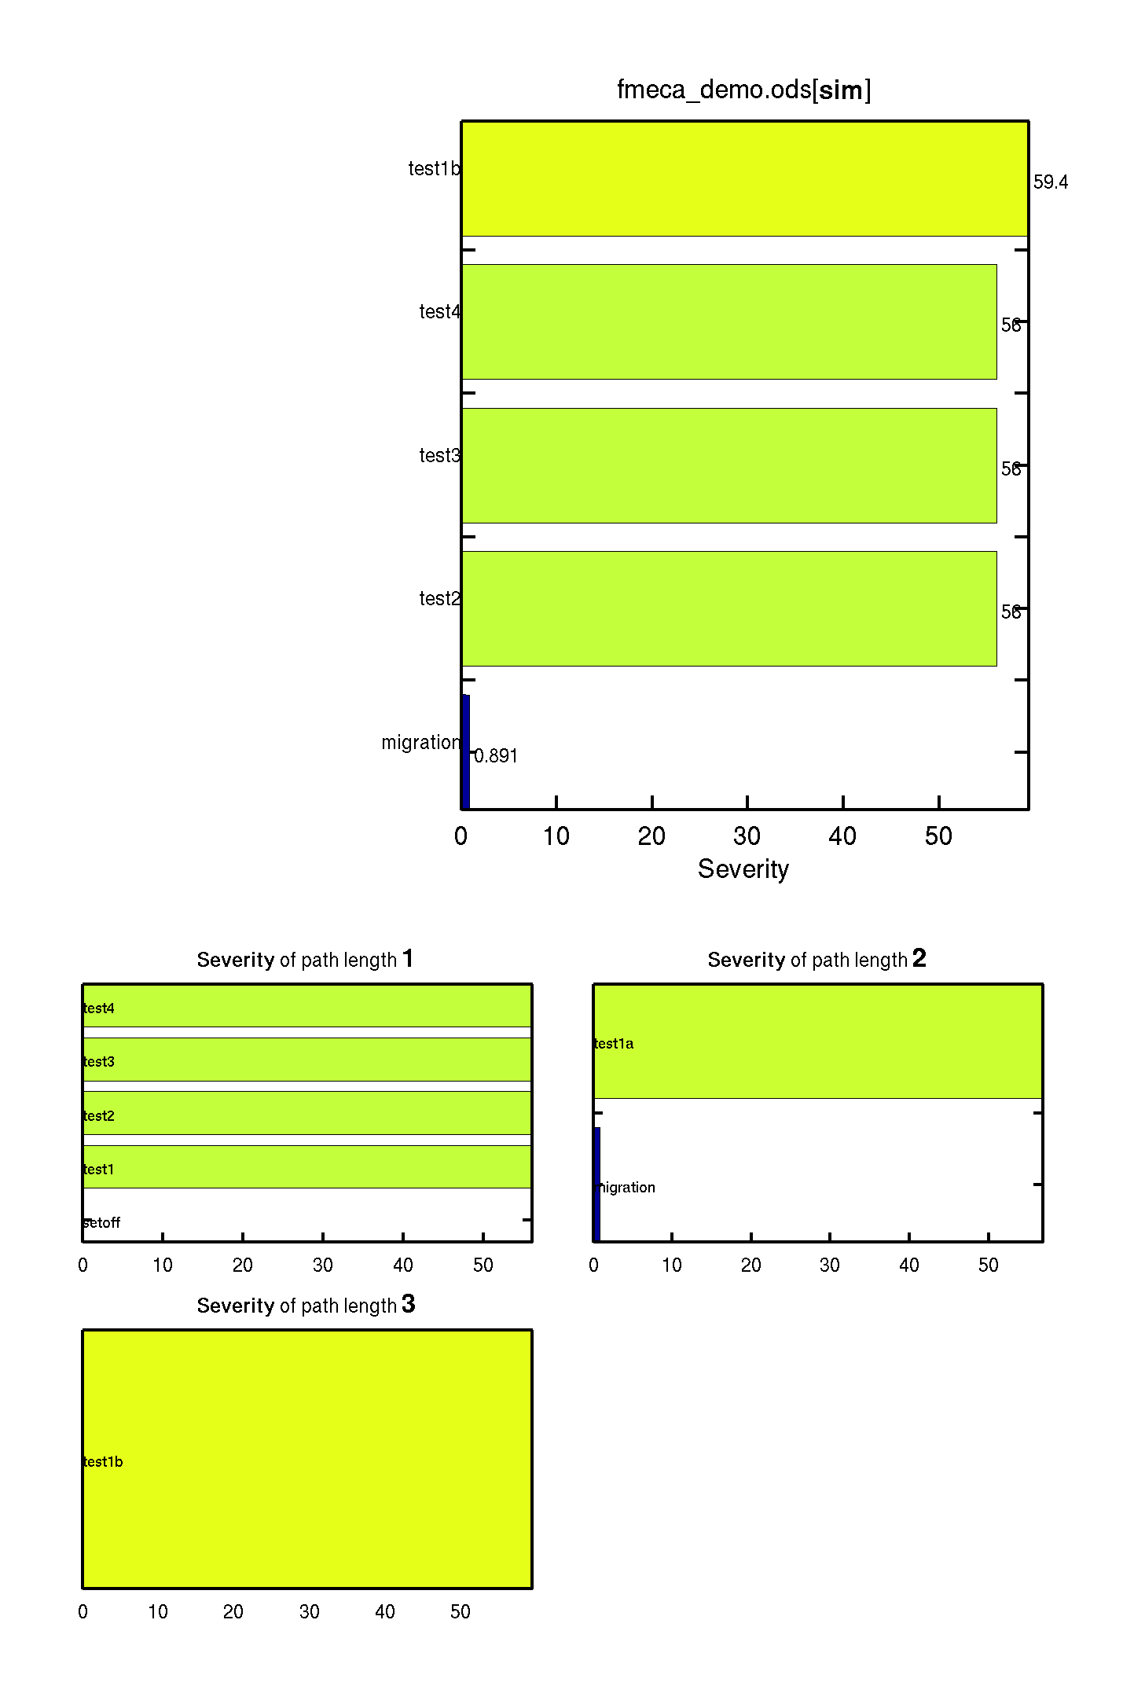
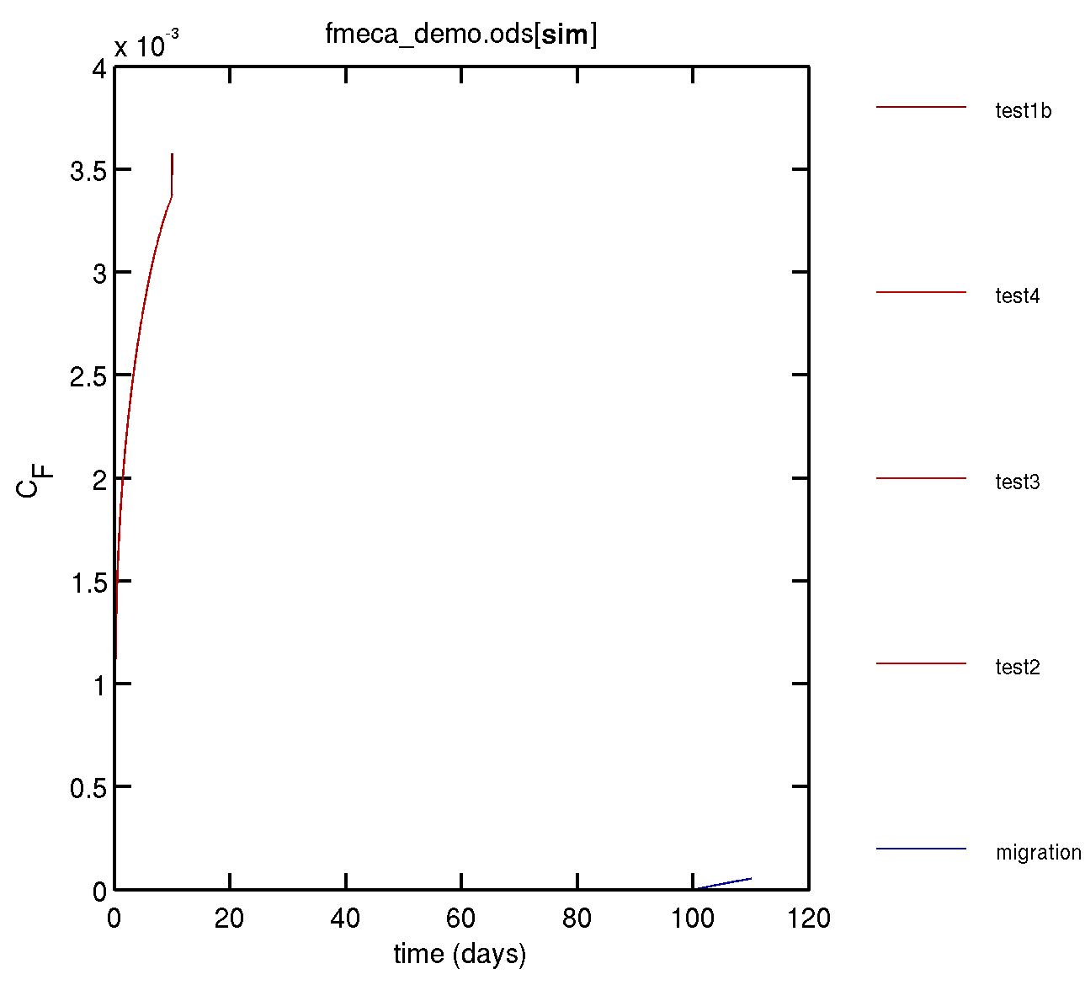
TOY EXAMPLE: outputs
INPUT TABLE =OpenOffice worksheet (ODS v. 3)
FMECAENGINE
OUTPUT TABLE =HTML report
FMECAENGINE
FMECAENGINE
FMECAENGINE
FMECAENGINE
RESULT GRAPH
OUTPUT PARETO CHART
OUTPUT KINETIC GRAPH
SEVERITY CHART

Slide 14
SENSIBILITY ANALYSIS
Principles : automatic creation of combinations (Foscale, Kscale)
Illustrative examples

Slide 15
CASE STUDY simulation chaining to assess cause trees
Cap
SETOFF
during storage before use
(100 days@25°C)
MICROWAVE HEATING
5 min @100°C
MIGRATION
HOT FILLING
(10 min @80°C)
Body
(multilayer)
LONG-TERM STORAGE
(200 days @25°C)

Slide 16
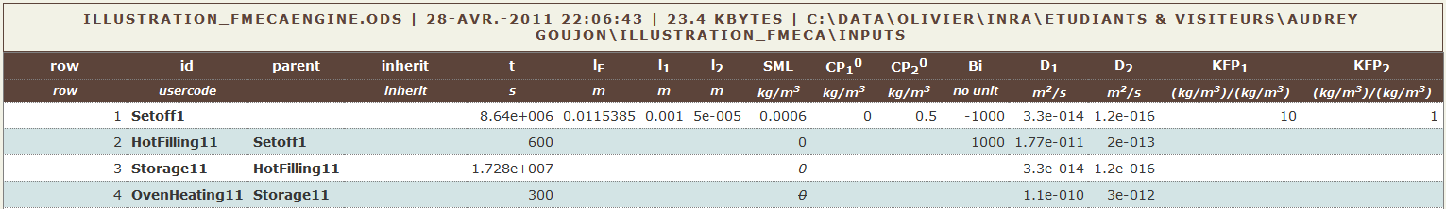
CORRESPONDING CODING
Geometry
Composition
Physico-chemical properties
Contact conditions
Contact conditions
Contact conditions
Contact conditions
SETOFF
HOT FILLING
STORAGE
HEATING
As most of values are inherited, the table is highly sparse.
Note that negative Bi values code for setoff (periodic boundary conditions).

Slide 17

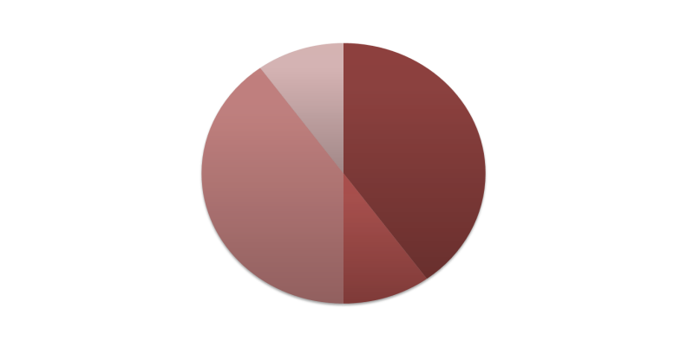
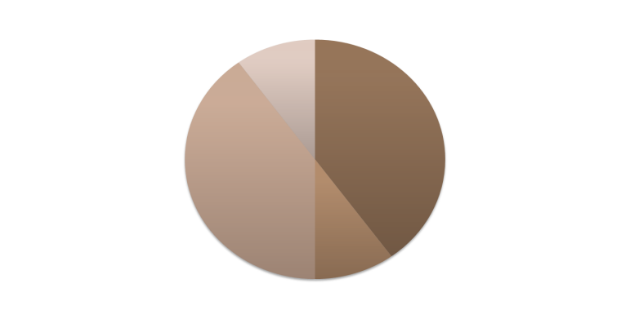
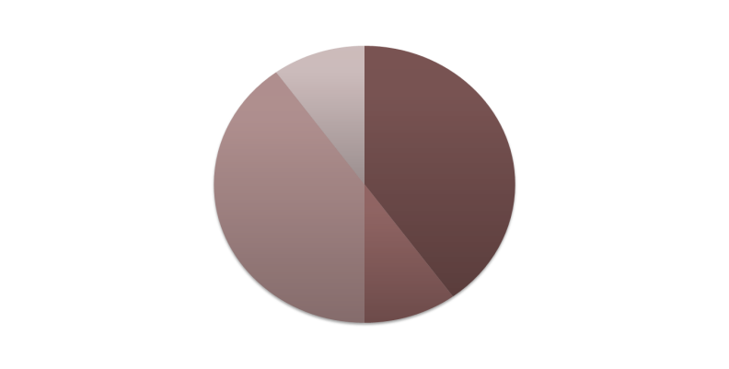
SENSITIVITY OF ANALYSIS An example: 3 levels for each first two steps

Slide 18
PRINCIPLES OF SENSITIVITY OF ANALYSIS 9 levels combinations
11 | 12 | 13
21 | 22 | 23
31 | 32 | 33

Slide 19
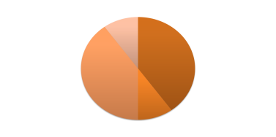
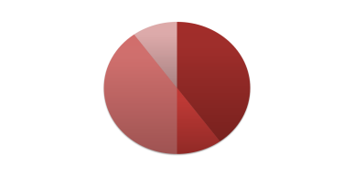

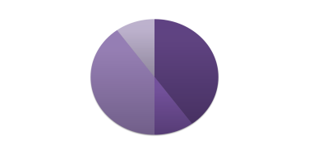

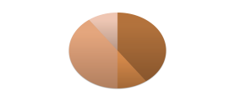





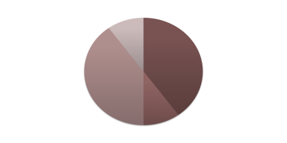

PRINCIPLES OF SENSITIVITY OF ANALYSIS APPLICATION TO SIMULATION CHAINING Mandatory rule = each step must have a single parent
11
12
21
22
31
32
13
23
33

Slide 20
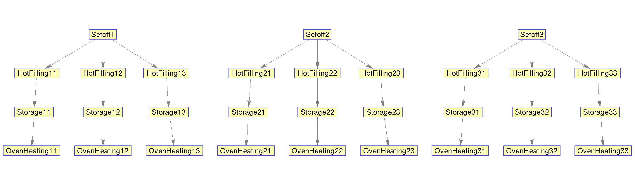
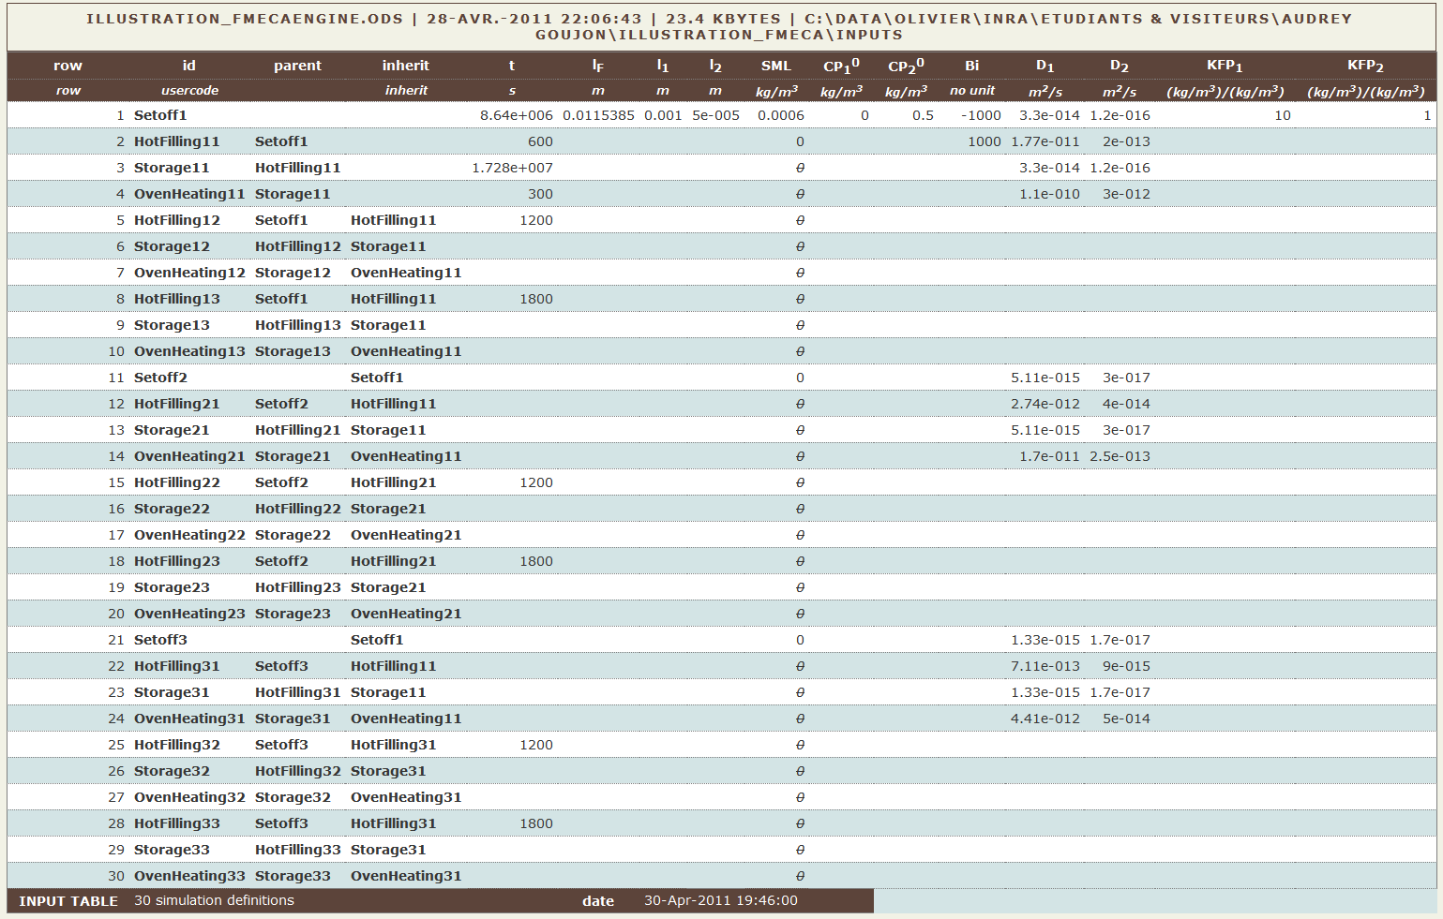
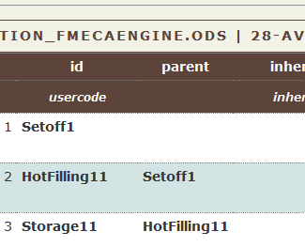
A FIRST INTUITIVE IMPLEMENTATION: by hands
Relationship defined
with “id” and “parent”
Note the
sparsity of inputs
INTPUT TABLE

Slide 21
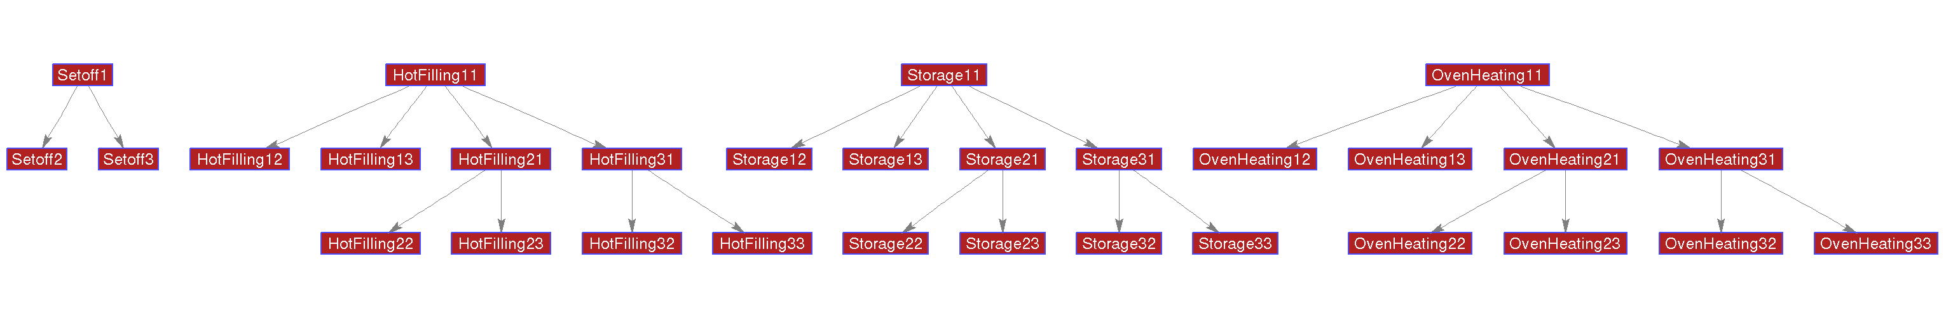
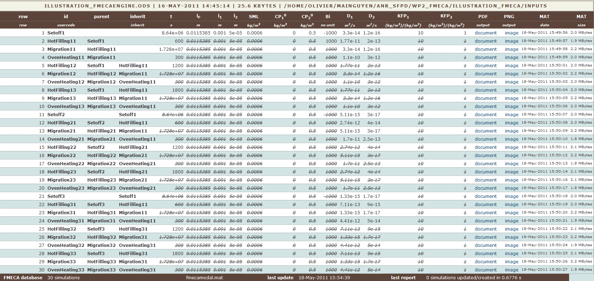
SPARSITY: PARAMETERS ARE MAINLY INHERITED
Reconstructed full table from column “inherit”
OUTPUT TABLE

Slide 22
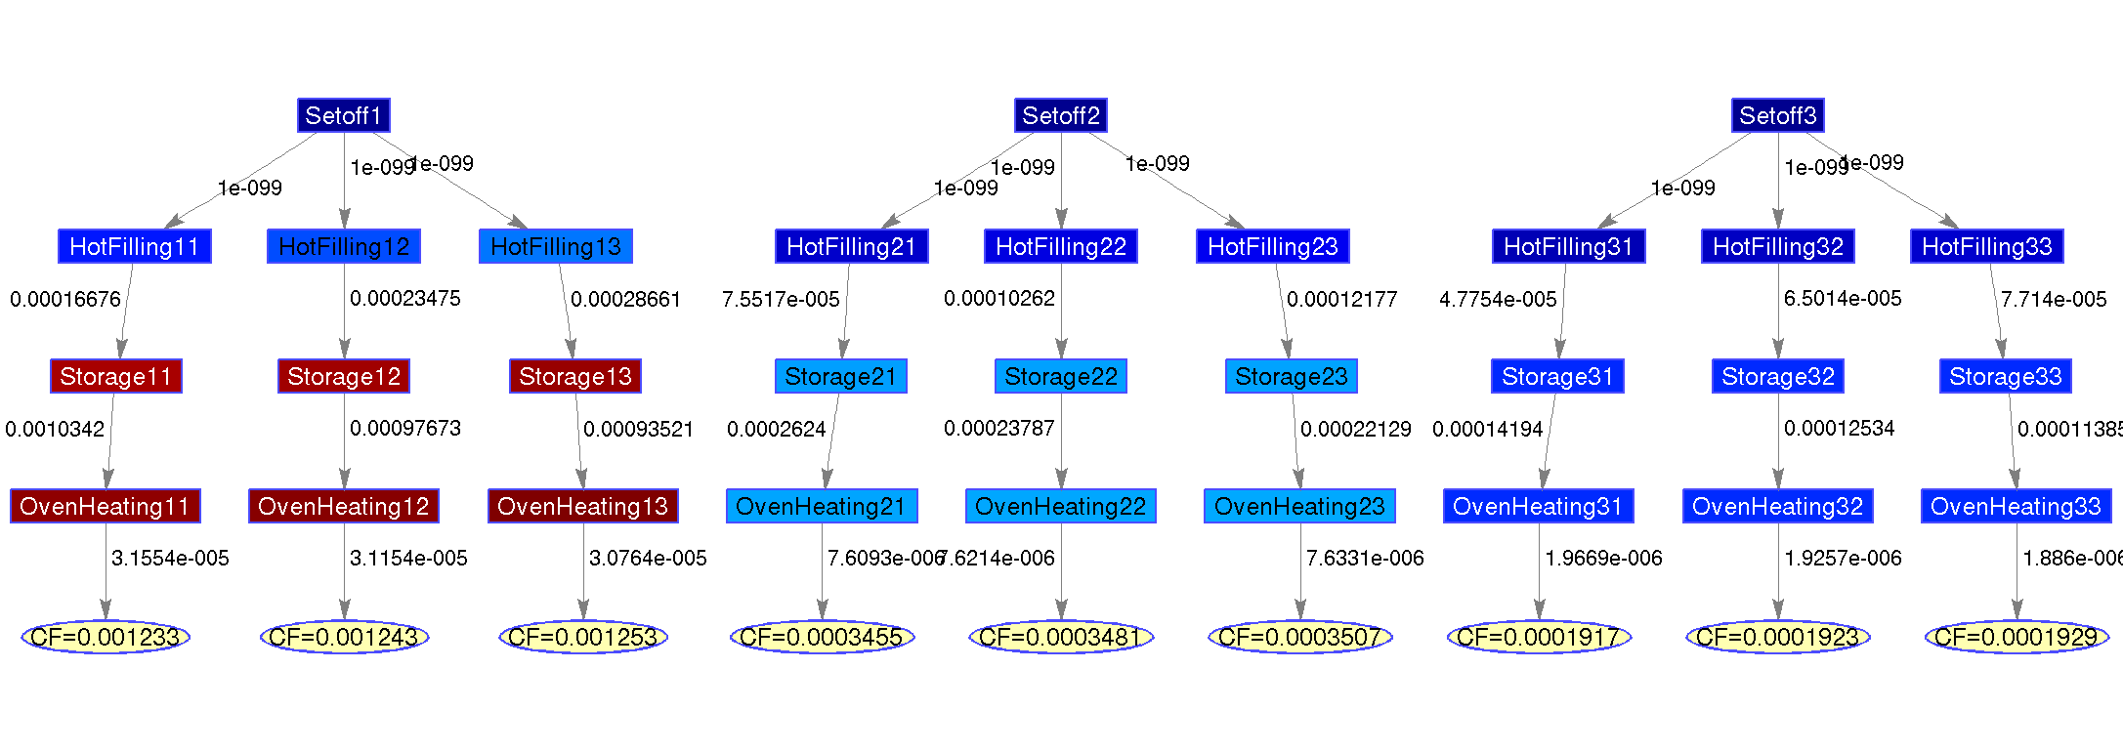
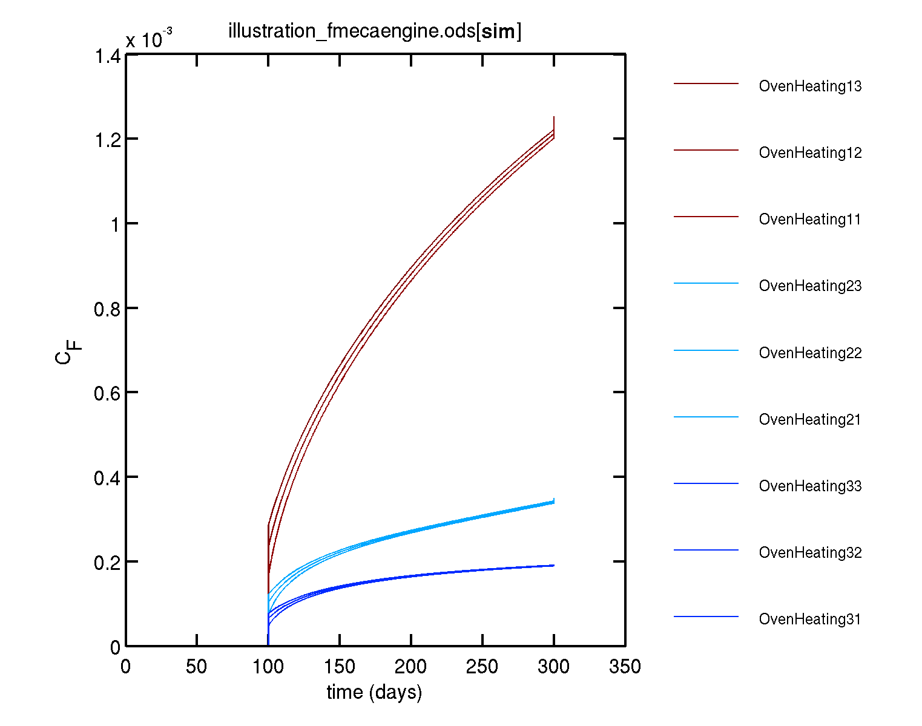


RAPID RESULTS ANALYSIS
Contribution
of HotFilling12
Final concentration
value in food
Color proportional to
The concentration in food (jet colormap).
concentration profil l in food for all steps
Comparison of all 9 scenarios
Severity of all 9 scenarios

Slide 23












COMBINATORICS via FMECAENGINE automation
Step n
The perturbation is applied only to step n
and then propagated to dependent steps
(e.g. local change of temperature/time)
Step n n+1 n+2
The perturbation is applied to all steps n,n+1,n+2,n+3…
(e.g. small/medium/large molecules)

Slide 24








ADVANCED EXAMPLE INPUT TABLE (automation columns: Foscale, Kscale) All valid Matlab syntaxes are eligible
SETOFF
HOT FILLING
STORAGE
HEATING
Column vector
2
1
Row vector
3
Column vector

Slide 25



Automatically created nodes are
yellow

Slide 26



COMBINATORICS: automatic inheritance
OUTPUT TABLE

Slide 27



ADVANCED EXAMPLE: Results
Kinetic profil for all scenarios
18 scenarios
(concentration
in food after the last step=OvenHeating)

Slide 28



COMBINATORICS: OMITTING STEPS
AUTOMATION
OUTPUT TABLE

Slide 29

OMITTING STEPS: FMECAENGINE builds all trees required to assess the effects of all combinations
Dependence
Inheritance

Slide 30


OMITTING STEPS: Results
Result graph: variation of final migration depending on combination
Kinetic graph: concentration profil in food for all steps (color corresponds to severity of final migration)

Slide 31


OMITTING STEPS: Results
Omitted step HOT FILLING
Omitted step OVEN HEATING
Omitted step SETOFF
Omitted step STORAGE
8 scenarios
(concentration
in food after the last step=OvenHeating)
Final concentration in food for each scenario length

Slide 32


COMPLEX ANALYSES WITH OMITTED STEPS A path towards FMECA-based risk assessment
Small/large diffusants
Good/poor chemical affinity

Slide 33



COMPLEX ANALYSES WITH OMITTED STEPS A path towards FMECA
OUTPUT TABLE

Slide 34



COMPLEX ANALYSES WITH OMITTED STEPS: Results
Kinetic profils for 24 scenarios
24 scenarios
(concentration
in food after the last step=OvenHeating)

Slide 35
SEVERITY and CRITICALITY ANALYSIS
Definition of severity
3 rules for risk migration and management → illustrative example

Slide 36






DEFINITION OF SEVERITY
Consumer
Exposure
mg/kg body weight
TDI
x 100
NOAEL
SAFE FOR HUMANS
SAFE FOR ANIMALS
HAZARDOUS
1 adult = 60 kg
eats 1 kg/day of
packaged food
x 60
Thresholds
mg/kg food
CHILDREN
ADULTS
NOT COMPLIANT
HAZARDOUS
x 3
SML_{children}
SML
× NOEL/TDI
Ĉ_{F}: (Over)estimated concentration
mg/kg food
× >NOEL/TDI
∞
33
100
Severity
MINOR, MODERATE
CRITICAL
CATASTROPHIC

Slide 37

THE SELECTED EXAMPLE ILLUSTRATES NON-INTUITIVE GROUND RULES FOR RISK MITIGATION AND MANAGEMENT
RULE 1
The final migration (consequence) in food does not depend on the order of « contamination » steps.
RULE 2
As migration is cumulative, the individual contribution of each step depends on its position in flowchart. An assessment of modal criticality independent of position is obtained by assessing the final migration without the step to evaluate.
RULE 3
The effect of conditional probabilities must be assessed on the final migration.
IMPLEMENTED GROUND RULES

Slide 38


CASE STUDY
severity is assessed
at the end of all steps
RISK PRIORITIZATION WITH FMECAENGINE
Ĉ_{F}

Slide 39

RULE 1: PERMUTING STEPS (involving a contact with food) DOES NOT CHANGE THE FINAL MIGRATION
EXCHANGEABILITY : SAME Ĉ_{F}
RESPONSABILITY ?

Slide 40

RULE 1: PERMUTING STEPS† DOES NOT CHANGE THE FINAL MIGRATION
food contact
Name of last step
end
contact time
begin
Permuted steps
†For steps involving a contact with food

Slide 41






RULE 2: THE MODAL CRITICALITY ASSOCIATED TO ONE OR A COMBINED STEP(S) IS OBTAINED BY OMITTING THE STEP TO ASSESS
LESS 2
LESS 1
ALL STEPS
Ĉ_{F}
Severity
Omitted step HOT FILLING
Omitted step OVEN HEATING
SML
Omitted step SETOFF
Ĉ_{F} (a.u.)
Omitted step STORAGE
33
100

Slide 42

RULE 2: CALCULATION PROCEDURE TO EXTRACT THE SEVERITY OF A SINGLE STEP
CRITICAL
STEP
CRITICAL
STEP
33
Severity of SETOFF
Severity of STORAGE
Severity(4 steps)-Severity(3 steps)

Slide 43




RULE 3: RATING COMBINED MODALITIES REQUIRES TO ASSESS THE CUMULATIVE EFFECT OF ALL COMBINATIONS (e.g. excessive storage and heating)
Storage : t and t⁺
t
t⁺
D
D⁺
additional
modalities
generated by
FMECAENGINE
Oven Heating : D and D⁺
Missing values
are inherited

Slide 44

RULE 3: RATING COMBINED EFFECTS here:tD < tD⁺< t⁺D < t⁺D⁺
t
t⁺
D
D⁺
D
D⁺
TO BE WEIGHTED BY EXPERTS

Slide 45



RULE 3: MODAL CRITICALITY ASSOCIATED TO [t,D] × [t⁺,D⁺] ➔ all sequences with omitted steps (1..3) are tested (43 simulations !).
TREE RESULTS
NAMES OF LAST STEP
TREE INHERITANCE BETWEEN TESTED CONDITIONS
NAMES
OF LAST STEP

Slide 46



RULE 3: MODAL CRITICALITY ASSOCIATED TO [t,D] × [t⁺,D⁺] ➔ all sequences with omitted steps (1..3) are tested (43 simulations).
t⁺D
t⁺D⁺
t
t,D
t+,D+
D⁺
Severity(4 steps)-Severity(3 steps)

Slide 47

RATING SEVERITY for a broad range of conditions
Increasing criticality
Severity of “storage” depends on context.
critical
catastrophic

Slide 48
HOW DOES IT WORK?
CF (substance 2)
SML₂
3
Acceptable
region
2
CF(substance1)+CF(substance2)
<Overall migration limit
3
1
2
1
CF (substance 1)
SML₁

Slide 49


APPLICATION: CONCURRENT DESIGN/SCREENING
DESIGN A
DESIGN B
?
?
Identification of
critical components
critical steps
uncorrectable design areas
Feed results into
Design
Quality management procedures
Suppliers audit
Considering related decisions

Slide 50










COMPLEX EXAMPLE OF COMBINED EFFECTS
M (g/mol)
200
350
600
Fatty contact
Aqueous contact
C_{F} scale

Slide 51


RATING SEVERITY for several migrants
Severity scale
M (g/mol)
200
350
600
33
100

Slide 52







RISK BALANCING between migrants
Severity scale
100
Setoff
SML
Hot filling
Fatty contact
Storage
Oven heating
Aqueous contact
SML
33
C_{F} + C_{F} ≤ min (SML , SML )

Slide 53
Connecting with physico-chemical databases
Relational databases
Key examples (coding with fmecaengine V 0.41 and later)

Slide 54





RELATIONAL DATABASES
Database = collection of tables including primary, super key and foreign keys
Examples
Monomer
Name C_name PMREF CAS M SML polymer class
Polymer
name composition
Additive
name PMREF CAS M SML Class
Affinity
food K

Slide 55
IMPLEMENTED RELATIONSHIPS
Implemented relationships include:
one-to-one relationships
one-to-many relationships
many-to-many relationships
cascading between keys
Operations above are coded using a special syntax (more flexible and concise than SQL) that mimics UML (http://en.wikipedia.org/wiki/Unified_Modeling_Language) :
PP:polymer::name->classadditives
PP:polymer::name->classadditives:substance::class->name
PP:polymer::name->classadditives:substance::class->M
By default, a UNIQUE operator operator (data reduction) is apply to all relationships involving strings or cell array of strings. The request order is respected only for single requests.
It is worth to notice that final results are also included within a large database that can be resused in future simulations or in subsequent analysis (e.g. for calculating severity).
Background:
http://en.wikipedia.org/wiki/Many-to-many_(data_model)
http://en.wikipedia.org/wiki/Junction_table
http://en.wikipedia.org/wiki/Foreign_key
http://en.wikipedia.org/wiki/Superkey
http://en.wikipedia.org/wiki/Associative_Entities

Slide 56
EXAMPLE OF ONE TO MANY RELATIONSHIPS The example depicts how databases could be used to derive the formulation (substance content) of a common polymer and finally to sample the distribution of molecular mass (M) of possible migrants. These values are finally used for the calculation of some estimates of diffusion coefficients (D).
Relation between databases
Additive
name PMREF CAS M SML Class
request
Polymer
name Composition
M | value
name | My polymer
composition
M | value
composition
M | value
Data operations (aggregation, reduction, calculation)
D_{estimate}
min, max, mean,
sampling
concatenate
median, percentile…
Previous request

Slide 57


TIP: the name of a substance can be replaced by a class of substance
M | value
M | value
request
 | monomer9
M | value
name | PP
M | value
 | antioxidant
M | value
 | UV_stabilizer
M | value
M | value
PERCENTILES
0,10, 20…100
%
100
50
M

Slide 58
RELATIONSHIPS are called KEY or KEY-to-KEY KEY2KEY syntax
Basic coding
keyA:tableA::columnA1->columnA2
keyA:tableA::columnA1->columnA2:tableB::columnB1->columnB2
keyA:tableA::columnA1->columnA2:tableB::columnB1->columnB2:tableC::columnC1->columnC2
Extended coding with mathematical operators
max(Dpiringer(PP,PP:polymer::name->classadditives:substance::class->M,40))
Dpiringer(PP,min(PP:polymer::name->classadditives:substance::class->M),40)
Extended coding with regular expressions
\antiUV{3|2}\ :substance::name->M
\.#PE.#\:polymer::name->classadditives:substance::class->name:substance::name->M
Extended coding with lists
LDPE|undefined|PP:polymer::name->classadditives:substance::class->name:substance::name->M

Slide 59
EXAMPLES
Collection of D
Dpiringer(PP,PP:polymer::name→composition:additive::class→M,25) ➔ D_{min}, D_{med}, D_{max}
Dpiringer(PP,min(PP:polymer::name→composition:additive::class→M,25))
ou D_{max}
max(Dpiringer(PP,PP:polymer::name→composition:additive::class→M,25) )
Collection of K
dairy:affinity::food→K ➔ K_{min}, K_{med}, K_{max}
Collection of SML
mean(PP:polymer::name→composition:additive::class→SML) ➔ SML_{mean}
➔Any valid Matlab expressions can be accepted

Slide 60

EXAMPLE with multiple keys note that all keys must be enclosed within ()
Dpiringer((LDPEYogurtBottle:scenario::id->polymer),
(LDPEYogurtBottle:scenario::id->polymer:polymer::acronym->composition:substance::technologicalclass->M),
(LDPEYogurtBottle:scenario::id->temperature:storage::id->temperature))

Slide 61
HOW TO BUILD USER DATABASES, RULEBASES, KNOWLEDGEBASES
Database, rulebase, knowledgebase = collection of tables including primary, super key and foreign keys

Slide 62
Examples: Tables of physico-chemical properties
Additive
InChIKey:string (U) Name:string CAS:list of strings PMREF:integer M:real SML:real TDI:real logP: real logPmin: real logPmax: real Class:string | NLZUEZXRPGMBCV-UHFFFAOYSA-N 2,6-Di-t-butyl-4-hydroxytoluene;2,6-di-tert-butyl-4-methyl phenol;4-Methyl-2,6-bis(2-methyl-2-propanyl)phenol;4-Methyl-2,6-di-t-butyl-phenol ;4-Methyl-2,6-ditertbutylphenol;BHT;Butylated hydroxytoluene;phenol, 2,6-bis(1,1-dimethylethyl)-4-methyl;2,6-Di-t-butyl-p-cresol 128-37-0;1948-33-0;25377-21-3;50-78-2;62698-56-0;720-39-8;950-56-1;97123-41-6 46640 220.35 3 0.05 5.2 5.32 5.03 Antioxidant
Monomer
InChIKey:string (U) Name:string CAS:list of strings PMREF:integer M:real SML:real TDI:real logP:list of reals Class:string Polymer:string | QQONPFPTGQHPMA-UHFFFAOYSA-N name: propene;1-propene;propylene;methylethene;1-propylene;prop-1-ene 115-07-1;33004-01-2;676-63-1 23980 42.08 60 NaN 1.7 propylene PP
Polymer
Acronym:string Name:string Class:string Density:real Composition: list of strings | PP polypropylene PO 0.95;0.92 antioxidant, UV_stablilizer, monomer
ALL DATA TYPES ARE RECOGNIZED IMPLICITELY ACCORDING TO THE FOLLOWING RULES
Empty cell Scalar List Unique (U) Primary/Foreign key | = Not A Number Any numeric value String containing “;” or “|” is enforced for all keys returning an array of strings Any key with string/char content (possibly including some lists)

Slide 63
EXAMPLES: RULE BASES AND KNOWLEDGE BASES
scenario
Primary key Foreign key List/Foreign key Foreign key Foreign key Foreign key Foreign key | Id: gobeletPP Food : hotdrink Foodsimulant: fatty, ethanol50 Material : PP Geometry : gobelet Step : consumption Temperature : hot
Geometry
Primary key List/ Foreign key List/ Foreign key List/ Foreign key List/ Foreign key List/ Foreign key | Id: gobelet A: 170 Aunit: cm2 mF: 200 mFunit: g lP : 150 lPunit : µm
Food
Primary key List/ Foreign key List/ Foreign key List/ Foreign key | Id: hotdrink Shelflife: 2 Shelflifeunit : h rhoF: 1000
Foodsimulant
Primary key List | Id: ethanol50 K: 0.1
Diffusion
Primary key List | InChIKey: NLZUEZXRPGMBCV-UHFFFAOYSA-N M: 220.35 polymer: PP rhoP: 0.95 temperature: 40 D: 4.6E-15;2.7E-16;5E-15
Consumption
Primary key List/ Foreign key List/ Foreign key List/ Foreign key | Id : hot Temperature: 70 Time: 2 Unit: h

Slide 64



POSSIBLE EXTENSIONS
Physicochemical properties
Building of the first substances database
Positive lists
AUTOMATIC TOOL TO IMPORT
NIST
Ncbi
ChemSpider
PubChem
EPA…
M
SML
TDI
logP
T_{boiling}
T_{melting}
Spectra :
-UV-V
-IR
-RMN
-Mass
Chromatogram
etc…
AUTOMATIC TOOL TO IMPORT
Spectra databases

Slide 65

DETAILED MANUAL
All functions can be downloaded at:
https://github.com/ovitrac/FMECAengine

